Slide 1


SECURITY RISK ASSESSMENT
FOR SYMETRICA AND HGA
SHREYA PATIL- CY5200- SECURITY ANALYSIS
Notes:
Hello and Greetings!
I am Shreya Patil and for today’s presentation I am going to talk about the cyber security risk analysis for two organizations, Hypothetical Government Agency a mid-size organization that transfers U.S government funds to individuals and Symetrica a small size design and manufacturing company that builds radiation detection and identification systems.

Slide 2
BUSINESS NEED FOR SECURITY RISK ANALYSIS FOR SYMETRICA
To understand the value of assets, data and people that constitute the organization
Understanding organizational vulnerabilities, operational priorities and ROI
Aligning security investments to meet business objectives with minimal loss
Evaluating roles and responsibilities to determine workforce recommendations.
To comply with government laws and regulations
SHREYA PATIL- CY5200- SECURITY ANALYSIS
Notes:
The first slide of this presentation describes business needs for security analysis for Symetrica. The first and foremost important reason is to identify the value of assets, data and people that form the organization. Conducting security analysis also helps in understanding the most critical organizational vulnerabilities, and operational priorities needed for smooth running of the business and Return On Investment. It also helps in identifying the security investments need to improve the efficiency of security controls which ultimately help in achieving business objectives of the organization with minimal financial loss. By identifying the threats, vulnerabilities and controls in place for the critical assets, the analysis also helps in evaluating roles and responsibilities to determine workforce recommendations for Symetrica. And last but not the least, the security analysis also helps in evaluating if the company is successfully complying with government laws and regulations.

Slide 3
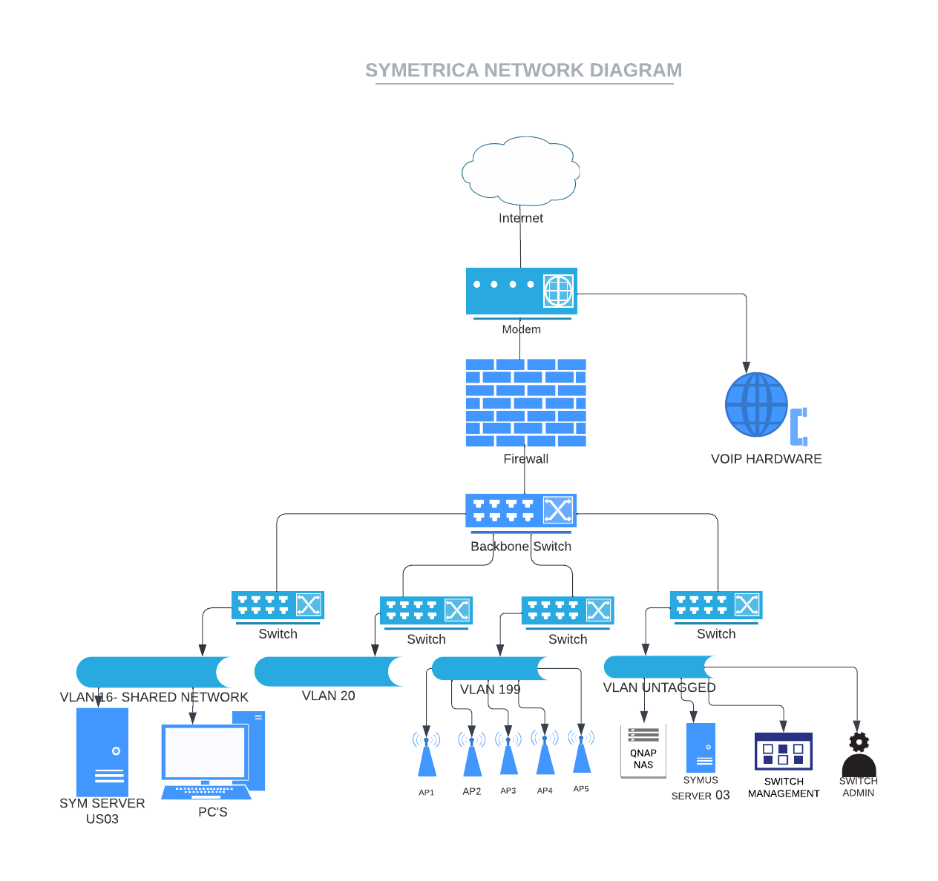
NETWORK TOPOLOGY
LIST OF CRITICAL ASSETS
ASSET | ASSET NAME | Asset Value
A1 | Backbone Switch | $15,000
A2 | Cable Modem | $35,000
A3 | Switches (X4) | $20,000
A4 | W Access Points (X5) | $25,000
A5 | MISys (maintains inventory) | $75,000
A6 | Symetrica US Server-03 | $100,000
A7 | Arena (all data and processes tied to the product) | $50,000
A11 | QNAP NAS | $65,000
A12 | UPS | $30,000
A13 | Firewall Sophos-XG-125 | $55,000
A14 | AWS Fleet Servers and services | $30,000
A15 | Gitlab services | $15,000
A16 | Jenkins/Builder | $45,000
A17 | PC’s | $85,000
A18 | Printers | $20,000
A19 | Phabricator | $60,000
A20 | Internal Correspondence | Intangible
A21 | Personnel Information | Intangible
A22 | Contracting and Procurement Documents | Intangible
A23 | Reputation (Intangible) | Intangible
A24 | Employee Confidence (Intangible) | Intangible
SHREYA PATIL- CY5200- SECURITY ANALYSIS
Notes:
The network topology describes the enterprise architecture for Symetrica. As a small sized company with limited number of employees, Symetrica has implemented basic network architecture where the firewall acts as the primary control. All the critical assets, the servers and the workstations of the company are located on their own secure VLANs to secure the communications within the company.
The diagram helps in understanding the architecture and various assets owned by Symetrica. But in order to conduct the security analysis and develop a good security program, there are various tangible and intangible assets of Symetrica that come under the scope. The table lists out all the critical assets utilized by Symetrica for day-to-day operations.

Slide 4
THREAT ANALYSIS, THREAT AGENTS, ATTACK TREE SCENARIOS
FOR SYMETRICA
Gain employee’s password
FOR HGA
Gain access to critical data
Look for logged in user console with access to data
Find physical copy of data in the office environment
Use password cracking tools
Bribe the working professional for the password
Look for it in the office and employee desk-spaces
Obtain admin password with access to data
Gain access to the backup files
Capture the data in transmission
Install the tool on victim’s console
Remotely gain access to the password
Inject USB drive with pre-installed software to gain access
Capture traffic to the ISP
Capture in the clear conversation
Install the tool on victim’s console
Remotely gain access to the password
Inject USB drive with pre-installed software to gain access
Capture traffic from/to the data server
Gain access to remote backup server
Find the network vulnerability
The victim is online and has valid authenticated access
Find the network vulnerability
The victim is online and has valid authenticated access
Gain access to the physical backup server
Tap any serial communications to the console
Capture the traffic while backing up
SHREYA PATIL- CY5200- SECURITY ANALYSIS
Notes:
This slide provides two attack tree scenarios, each providing threat analysis for exploiting vulnerabilities for two organizations i.e., Symetrica and HGA.

Slide 5
RESIDUAL SECURITY RISKS DUE TO MISSING CONTROLS
ACCESS CONTROL RISK MANAGEMENT:
INTERRUPTION OF OPERATIONS
UNAVAILABILITY OF SERVICES
NETWORK RELATED ATTACKS
DAMAGE AND LOSS OF PHYSICAL ASSETS
IMPROPER FUNCTION OF INFRASTRUCTURE
NETWORK RISK MANAGEMENT:
DETERIORATION OF NETWORK LINKS THROUGHPUT
LOSS OF PERSONALLY IDENTIFIED INFORMATION
MASQUERADE AS AN AUTHORIZED USERS
CREATION OF BACKDOORS DUE TO ROGUE AP
INSTALLATION OF MALWARTE ON SYSTEMS
NETWORK MANAGEMENT RISK MANAGEMENT:
EXHAUSTION OF RESOURCES
FULL SYSTEM COMPROMISE
WEAK NETWORK INFRASTRUCTURE
LOSS OF CONTROL OVER NETWORK INFRASTRUCTURE
MANIPULATION OF SENSITIVE INFORMATION IN LOG FILES
SHREYA PATIL- CY5200- SECURITY ANALYSIS
Notes:
This slide highlights a list of potential risks due to missing risk management controls in access control and network risk management areas. Interruption of operations, unavailability of services, damage and loss of physical assets are few of the potential risks due to missing controls in access control risk management. Deterioration of network links throughput, loss of personally identified information, exhaustion of resources, full system compromise are few of the potential risks due to missing controls in network and network management risk management areas.

Slide 6
RESIDUAL SECURITY RISKS DUE TO MISSING CONTROLS
DATABASE RISK MANAGEMENT:
PRIVILEGE ESCALATION
RESOURCE EXHAUSTION DUE TO MALFORMED QUERIES
LOSS OF CONTROL OF INFRASYRUCTURE BACKBONE
USER ACCOUNT DATA EXPOSURE
NON-COMPLIANCE
APPLICATION RISK MANAGEMENT:
MANIPULATION OF DATA
UNAUTHORIZED FOLDERS AND DATA ACCESS
FAILURE OF ACCESS CONTROLS
REMOTE CODE EXECUTION
INABILITY TO IDENTIFY THE BREACH
WIRELESS RISK MANAGEMENT:
MANIPULATION OF DNS SERVER SETTINGS
MOUNTING FIRMWARE ON ROUTERS
BLOCKING LEGITIMATE BLUETOOTH TRAFFIC
LOSS OF CONTROL OVER NETWORK INFRASTRUCTURE
DATA MODIFICATION AND INSTALLATION OF MALWARE
SHREYA PATIL- CY5200- SECURITY ANALYSIS
Notes:
This slide is a continuation of potential residual security risks due to missing controls in area of database, application, wireless risk management areas. Privilege escalation, resource exhaustion due to malformed queries, manipulation of data, unauthorized folders and data access, manipulation of DNS server settings and mounting firmware on routers are few of the potential risks due to missing controls in database, application, wireless risk management areas.

Slide 7
LIST OF VULNERABILITIES, THEIR RISKS AND RECOMMENDED PREVENTION CONTROLS
Security Awareness Training programs highlighting the higher probability threats can be made more frequent.
Separate the management traffic and manage the privileged access by using a server that provides authentication, authorization and accounting services to assign privileges and store access information.
Implementation of Multi Factor Authentication with biometrics/ security device can also help to mitigate vulnerabilities to greater extent.
Implement separation of network, such as moving the servers and application accessible via internet to DMZ can help to prevent lateral movement of attacks.
Implement principle of least privilege and limit lateral communication between PC’s and management interfaces.
Disable remote admin network protocols such as FTP, Telnet and safeguard configuration files using encryption or access controls during transit, storage, and back up of files.
List of top vulnerabilities:
Unauthorized infrastructure access, administrative privileges exploitation
Vulnerabilities related to Unauthorized Access
Installation of malware, improper certificate validation
Rogue WIFI Access Points (WAPS), Vulnerabilities related to non-encrypted 802.11 traffic
Sensitive data disclosure, autorun feature vulnerabilities
SHREYA PATIL- CY5200- SECURITY ANALYSIS
Notes:
Based on the list of potential risks provided in the previous slides, here is a list of vulnerabilities and few recommended prevention controls to reduce the probability of exploiting a vulnerability. Training personnel, separating management traffic, implementing MFA, segregating network for defense-in-depth approach, implementation of principle of least privilege and disabling remote admin network protocols are few of the recommended prevention controls.

Slide 8
LIST OF ASSET RISKS, THEIR RISKS AND RECOMMENDED RESPONSE CONTROLS
List of top risks:
loss of control of infrastructure backbone
Weak network infrastructure, attackers maintain persistence within the network
Remote code execution, inability to identify the breach
Might cause interruption of operations due to authenticating non trusted access
Loss of Personally Identified Information, Breaches on FTP and HTTPS sites, attacks related to accepting uploaded data.
Intrusion Prevention Systems and regular update of digital signatures need to be done to proactively mitigate uprising threats.
Patches need to be regularly checked, tested in an isolated environment and patched.
Audit Trails control can be implemented and reviewed to identify potential service and process problems.
Intermittently test the security configurations, backup the configurations and store them offline.
Continually monitor and assess the security of management and critical systems, networks and infrastructure.
SHREYA PATIL- CY5200- SECURITY ANALYSIS
Notes:
This following slide provides list of risk and recommended response controls to mitigate the impact on assets based on potential risks. Updating digital signatures, patch management, implementation and review of audit trails, backup and testing the security configuration and regularly assessing the risk are few of the recommended response controls

Slide 9
SECURITY RISK MANAGEMENT RECOMMENDATIONS
BUDGET FOR SYMETRICA
Secure access to the consoles, routers, and switches by controlling remote administration access and implement robust password policies for stronger authentication.
Authorize Processing (Certification and Accreditation) controls needs to be implemented to prevent from trusting non-authorized parties.
Document, review and update the Disaster recovery, Business continuity and continency plans.
Implement security checklist to audit and harden the application configurations and allow only the application modules and services that are required as per business needs.
Implement AES CCMP or above encryption protocols for WPA-2 enterprise networks.
Reviewing and monitoring the log files of networking devices, can help in identifying potential exploitation attempts, to harden the networking devices
Implement MFA and EAP-TLS certificate or above based methods to ensure secure authentication for wireless transactions
For Symetrica:
Residual Risk with current controls= $500,000
Residual Risk with new controls= $75,000
Proposed Security Budget Cost: $300,000
Residual Risk= Risk with current controls- Risk with new controls
= 500,000-75,000= 425,000
Proposed Security Budget Cost for 3 budgets:
Cost benefit ratio analysis for proposed budget:
Proposed Security Risk Budget cost/ expected security risk benefit
= 300,000/425,000
=0.71
SHREYA PATIL- CY5200- SECURITY ANALYSIS
Notes:
This slide provides various security risk recommendations based on the risk prevention and response control identified earlier. The right side of the slide provides the proposed security budet for Symetrica and cost benefit ratio analysis for the proposed budget.

Slide 10
RETURN OF INVESTMENT ANALYSIS FOR SYMETRICA COMPARED TO HGA
Security Risk Management Areas | HGA | Symetrica
Industry | Financial company | design and manufacturing company
Mission | Transfer U.s government funds in form of paychecks to individuals | To provide the very best overarching threat detection and identification solutions to facilitate the security teams to make smart decisions in multi-threat situations.
Geographic Presence | United States of America | United States of America, United Kingdom
Number of Employees | 500 | 100
Network Topology | Appendix 3 | Appendix 4
Critical Assets in $ | 274,000 | $725,000
Threat Agent | State sponsored, hacker group threat agents | Terrorist and Criminal group threat agents
Residual Security Risk in $ | $1,169,028 | $425,000
Budget for Risk Prevention and response controls, methods, policies | $470,000 | $300,000
$ security budget / $ security risk improvement | 0.4 | 0.7
$ security budget / $ critical assets | 0.17 | 0.41
$ security budget / employee | 548 | 3000
SHREYA PATIL- CY5200- SECURITY ANALYSIS
Notes:
This slide provide ROI analysis comparison between Symetrica and HGA. The table talks about the type of industries the organizations are involved in, their mission, geographic locations, size of the company, value of critical assets they own, what the threat environment looks like based on the threat agents, value of residual security risk, budget for both the companies, and value of Return of investment.

Slide 11
CYBERSECURITY WORKFORCE RECOMMENDATIONS
Manage and store the access information personnel by using Authentication, Authorization and Accounting services, to limit the access and only required privileges to the user.
Implementing security awareness and training highlighting the most exploited vulnerabilities is recommended
Participation of personnel in incident response plan testing exercise, helps them gain more knowledge on business continuity plans for the company.
Develop roles and responsibilities relating to cybersecurity tasks within the organization.
Personnel background check and Identification access management needs to be reviewed periodically
All the policies that identifies and assigns various roles and responsibilities, are required to be reviewed and approved by all the identified personnel.
Implementation of process of approval and review of policies by senior management is recommended
SHREYA PATIL- CY5200- SECURITY ANALYSIS
Notes:
After highlight various prevention and response controls for reducing vulnerability exploitation and risk mitigation, this slide highlight various workforce recommendations to improve cybersecurity posture of Symetrica. Since Symetrica is a small sized company, it has struggled in implementing cybersecurity-based organizational hierarchy within the company. In order for building an efficient cybersecurity posture, the following recommendations can be considered. implementation of AAA services, frequent security awareness training to all the personnel, incident response testing, developing cybersecurity-based roles & responsibilities, IAM, review of policies and senior management involvement in policy approval and review are few of the workforce recommendations for Symetrica.

Slide 12
CALL TO ACTION
ORGANIZATIONAL OVERVIEW: Symetrica is a small-size company that builds radiation detection and identification systems. Since the company's systems have been developed for security applications, it is necessary to review and build stronger cybersecurity posture for the organization.
SECURITY RISK ASSESSMENT: The assessment identified various vulnerabilities, risks and threat analysis for Symetrica.
SECURITY POLICIES AND CONTROLS: Various controls recommended for Symetrica, were based on organizations priorities and the critical assets required for operation of the company.
CYBERSECURITY RECOMMENDATIONS: Based on the identified potential risks, their impact and threat analysis for Symetrica, it is necessary to consider the recommended controls for mitigating the impact of various risks.
FUTURE SCOPE: For a good security program, Symetrica can strive to develop a fully integrated and cost-effective Risk prevention and response controls framework.
SHREYA PATIL- CY5200- SECURITY ANALYSIS
Notes:
In conclusion this slide for call to action provides an overall view for the organization, the security risk assessment conducted, the effectiveness of policies and controls, consideration of cybersecurity recommendation provided and the future scope to improve the security posture of Symetrica.
In order to perform the security risk assessment, Symetrica’s most critical assets, there threats and vulnerabilities were identified.
Various controls were recommended for Symetrica, based on the missing controls to meet the objective of organizations priorities and secure the critical assets which are required for day-to-day operation of the company.
Along with recommending various controls, to ensure efficient implementation of such controls, various workforce recommendations were provided within this analysis.
Although Symetrica has done a great job in implementing security controls to meet the business goals and compliance requirement, this security Assessment helped in shedding some light on various cost-effective Risk prevention and response control that help Symetrica develop a fully integrated good security posture.

